Slide 1
UE24CS352A — MACHINE LEARNING MINI-PROJECT
Predicting a Decline in Patient Reported Outcomes for
Cancer Patients on Chemotherapy
Problem Statement #8 | Team-15 | SEC K

Slide 2
UE24CS352A - MACHINE LEARNING MINI-PROJECT
INTRODUCTION
Team No. 15
Problem Statement #8: Predicting a Decline in Patient Reported Outcomes for Cancer Patients on Chemotherapy
Section: K
Team Member 1: -
Name: Shrujan N
SRN: PES1UG24CS624
Team Member 2: -
Name: Dhanush S Shekhar
SRN: PES1UG24CS662

Slide 3
UE24CS352A - MACHINE LEARNING MINI-PROJECT
1. Clinical Context & Objective Overview
• Chemotherapy causes severe physical adverse effects (fatigue, pain, cognitive slowing).
• Clinical blood tests do not measure how patients actually feel day-to-day.
• Patient Reported Outcomes (PROs) measure subjective health using PROMIS Global Physical Health (GPH) scores.
• GPH score population distribution: Mean = 50, Standard Deviation = 10.
• Goal: Predict health decline BEFORE chemotherapy day 1 to enable early supportive interventions.

Slide 4
UE24CS352A - MACHINE LEARNING MINI-PROJECT
2. End-to-End Pipeline Architecture
STAGE 1
Dataset Generation
generate_dataset.py
Simulates 1,252 patient records with vitals, labs, and targets.
STAGE 2
Time-Decay Featurizer
featurization.py
Applies w_i = exp(-t/365) and builds KNN & Binned matrices.
STAGE 3
Baseline Models
train_baselines.py
10-Fold CV on LASSO, Ridge, Elastic Net, and KNN.
STAGE 4
Advanced ML Models
train_advanced.py
Trains LightGBM, RF, SVM, and FFNN on 80/20 train/test split.
STAGE 5
Ablation & ROC Plots
ablation_and_plots.py
Builds Soft-Voting Ensemble, strips features, and plots ROC curves.

Slide 5
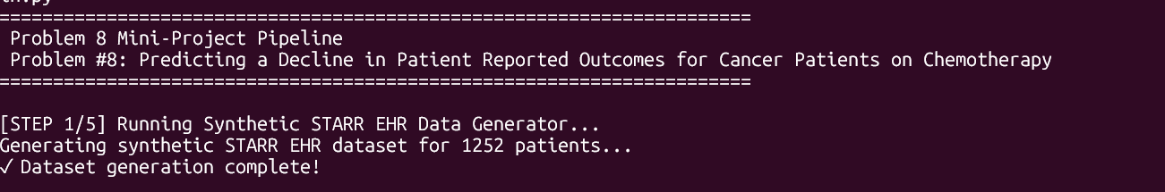
UE24CS352A - MACHINE LEARNING MINI-PROJECT
PIPELINE STAGE 1: Synthetic Dataset Generation (generate_dataset.py)
Step 1 generates our synthetic STARR cohort of 1,252 cancer patients, creating 6 months of pre-chemotherapy clinical history and target outcome labels while preventing data leakage
• generate_dataset.py uses numpy.random with seed 42 to create 1,252 patient records.
• For each patient, it generates: Baseline PROMIS GPH physical health score (mean = 48.5, std = 9.2).
• 6 months of historical time-series events (5 to 20 visits per patient) containing 7 vitals, 149 lab tests, 291 procedures, 266 diagnoses, 121 medications, and 5 utilization metrics.
• Calculates y_drop (1 if health score drops >= 10 points; 0 otherwise) and y_threshold (1 if health score <= 40; 0 otherwise).
• Saves summary data to data/patients_summary.csv and longitudinal data to data/raw_patients_longitudinal.npy.

Slide 6
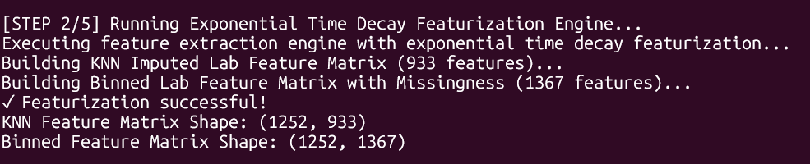
UE24CS352A - MACHINE LEARNING MINI-PROJECT
PIPELINE STAGE 2: Time-Decay Feature (featurization.py)
Step 2 converts longitudinal medical records into static feature matrices using exponential time-decay weighting w_i = e^(-t/365). It builds two competing representations: a 933-feature KNN imputed matrix and a 1,367-feature binned matrix.
• For every patient, featurization.py calculates an exponentially time-decayed average for every lab test and vital sign: f = sum(w_i * x_i) / sum(w_i), where w_i = exp(-t_i / 365), where t_i is the number of days before chemotherapy start date (t=0).
• Matrix 1 (KNN Imputed - 933 Features): Uses KNNImputer(n_neighbors=5) to fill missing lab values based on Euclidean distance across similar patients.
• Matrix 2 (Binned Labs - 1,367 Features): Splits lab values into 3 tertile bins (T1, T2, T3) plus a 4th explicit binary indicator variable (is_missing = 1 if missing, 0 if present).
• Saves matrices to data/X_knn_933.csv, data/X_binned_1367.csv, and data/y_targets.csv.
• Time Decay: A lab test done 2 days before chemotherapy (w approx 1.0) is much more important than a test from 5 months ago (w approx 0.61).
• Dual Matrices: Tests whether continuous numerical imputation (KNN) or discrete binning with missingness indicators performs better.

Slide 7
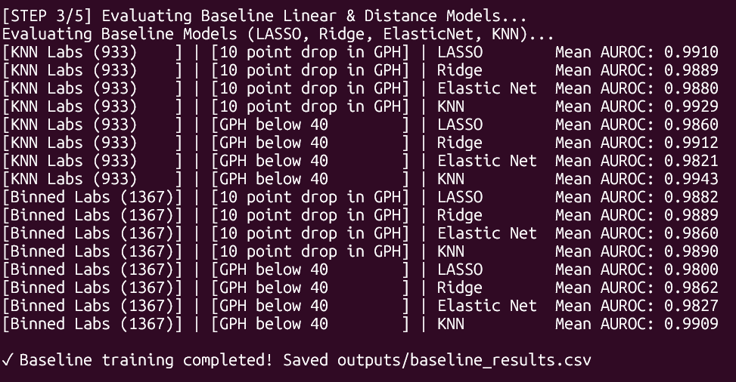
UE24CS352A - MACHINE LEARNING MINI-PROJECT
PIPELINE STAGE 3: Baseline Models Evaluation (train_baselines.py)

Slide 8
UE24CS352A - MACHINE LEARNING MINI-PROJECT
PIPELINE STAGE 3: Baseline Models Evaluation (train_baselines.py)
Step 3 runs 10-fold cross-validation on our baseline models—LASSO, Ridge, Elastic Net, and KNN—using standardized scaling to establish linear benchmark AUROC scores.
• Establishes simple linear benchmark scores to determine if complex non-linear models actually improve prediction accuracy.
• Uses 10-fold Stratified Cross-Validation (KFold(n_splits=10)).
• Inside every fold, StandardScaler() scales training data (mean=0, std=1) and fits 4 baseline models:
• 1. LASSO (L1): Regularized logistic regression forcing useless feature weights to zero.
• 2. Ridge (L2): Regularized logistic regression shrinking feature weights smoothly.
• 3. Elastic Net: Combined L1 + L2 regularized logistic regression.
• 4. KNN: Distance-based classifier (K=35).
• Calculates mean AUROC score across all 10 folds and saves to outputs/baseline_results.csv.

Slide 9
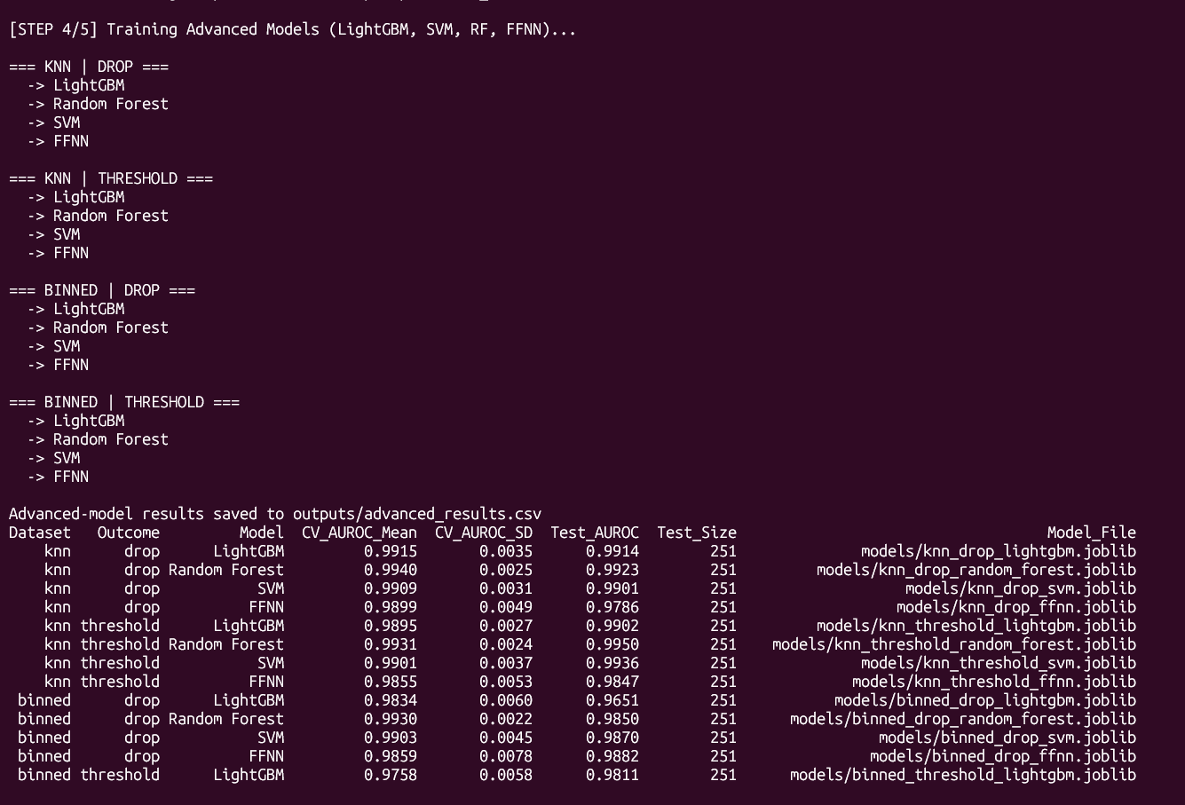
UE24CS352A - MACHINE LEARNING MINI-PROJECT
PIPELINE STAGE 4: Advanced ML Models Training (train_advanced.py)

Slide 10
UE24CS352A - MACHINE LEARNING MINI-PROJECT
PIPELINE STAGE 4: Advanced ML Models Training (train_advanced.py)
Step 4 trains our advanced models—LightGBM, Random Forest, SVM, and Neural Networks—evaluating performance on a held-out test split and saving binary model weights into models/
• Non-linear models capture multi-variable clinical interactions (e.g., high blood pressure combined with low kidney function) that linear models miss.
• Splits data into an 80% training set and a 20% held-out testing set (train_test_split).
• Fits 4 advanced non-linear algorithms:
• 1. LightGBM: Gradient boosted decision trees built sequentially to minimize log-loss.
• 2. Random Forest: 400 independent decision trees voting together.
• 3. SVM: Support Vector Classifier with RBF kernel maximizing hyper-plane decision margins.
• 4. FFNN: Multi-Layer Perceptron Neural Network (128 -> 32 nodes) with Adam optimizer and early stopping.
• Evaluates on held-out test split and serializes trained model objects into models/*.joblib.
• Saves output summary to outputs/advanced_results.csv.

Slide 11
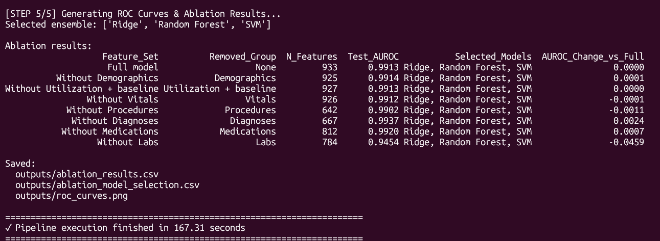
UE24CS352A - MACHINE LEARNING MINI-PROJECT
PIPELINE STAGE 5: Ablation & ROC Generation (ablation_and_plots.py)

Slide 12
UE24CS352A - MACHINE LEARNING MINI-PROJECT
PIPELINE STAGE 5: Ablation & ROC Generation (ablation_and_plots.py)
Step 5 builds our Soft-Voting Ensemble model and performs feature ablation by stripping away feature categories one by one. It proves laboratory histories carry primary predictive signal and renders our ROC curves into outputs/roc_curves.png
• Ablation: Proves WHICH feature categories actually drive clinical predictions. Removing Labs caused the biggest drop (AUROC -> 0.9454), proving laboratory trends carry critical diagnostic weight.
• 1. Selects top constituent models (Logistic + Tree + SVM) to build a Soft-Voting Ensemble.
• 2. Evaluates full ensemble on test set.
• 3. Removes one feature group at a time (Demographics, Vitals, Labs, etc.), retrains the ensemble, and measures the change in AUROC (delta AUROC).
• 4. Renders ROC curves using matplotlib and saves to outputs/roc_curves.png.

